Slide 1
Organising Code with Functions
Computer Programming and Algorithms 24/25

Slide 2
Learning Objectives
Understand that functions are blocks of code that can be called from somewhere else
Understand how functions interact with program memory and sequence of operations
Understand how we can use functions to make our code vastly more readable

Slide 3
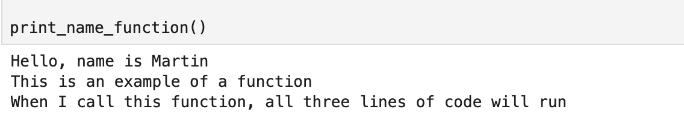
What is a function?
A Python function is a block of code that only runs when it is called
We can run (or call) a function by typing its name followed by ()

Slide 4
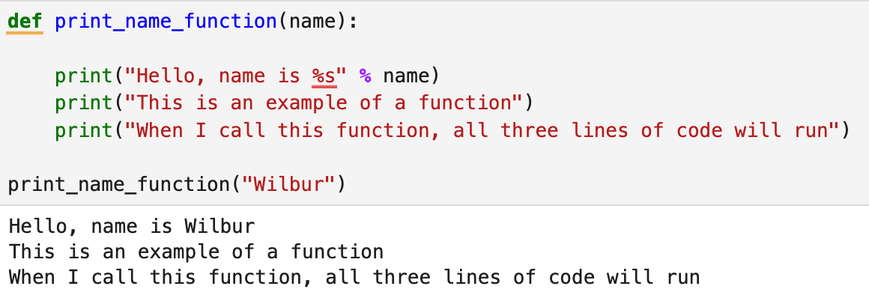
What is a function?
Functions can have inputs

Slide 5
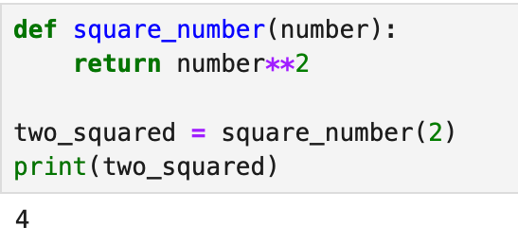
What is a function?
Functions can have inputs and outputs

Slide 6
Learning Objectives
Understand that functions are blocks of code that can be called from somewhere else
Understand how functions interact with program memory and sequence of operations
Understand how we can use functions to make our code vastly more readable

Slide 7
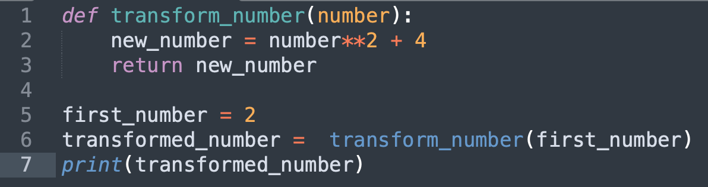
What happens when we call a function?
Program memory
Program counter: 1

Slide 8
What happens when we call a function?
Program memory
Program counter: 2

Slide 9
What happens when we call a function?
Program memory
Program counter: 3

Slide 10
What happens when we call a function?
Program memory
Program counter: 5
first_number
2
Int

Slide 11
What happens when we call a function?
Program memory
Program counter: 1
Function memory
first_number
2
Int
number
2
Int

Slide 12
What happens when we call a function?
Program memory
Program counter: 2
Function memory
first_number
2
Int
number
2
Int
new_number
8
Int

Slide 13
What happens when we call a function?
Program memory
Program counter: 3
Function memory
first_number
2
Int
number
2
Int
new_number
8
Int

Slide 14
What happens when we call a function?
Program memory
Program counter: 6
first_number
2
Int
transformed_number
8
Int

Slide 15
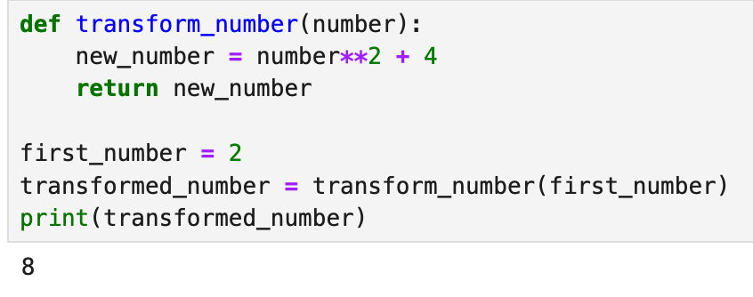
What happens when we call a function?

Slide 16
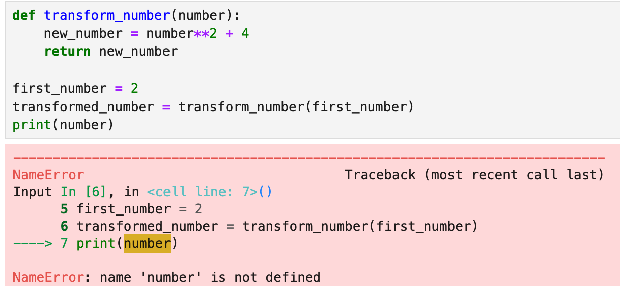
What happens when we call a function?

Slide 17
Learning Objectives
Understand that functions are blocks of code that can be called from somewhere else
Understand how functions interact with program memory and sequence of operations
Understand how we can use functions to make our code vastly more readable

Slide 18
When should we use a function?
We should use functions to avoid repetition of code (DRY).
We should use functions to make our code easier to read.

Slide 19
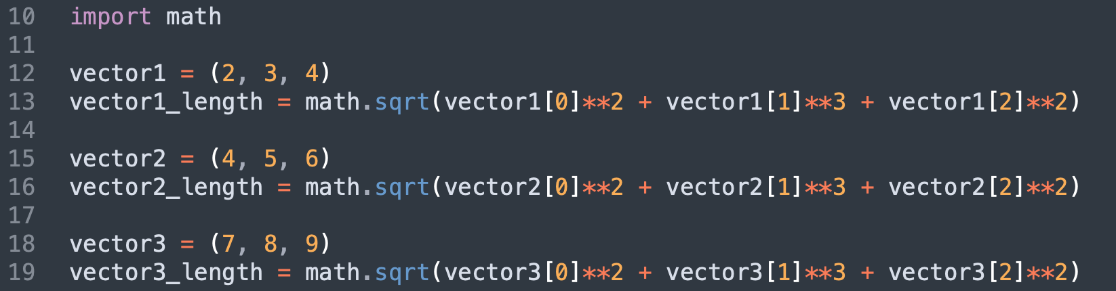
Don’t repeat yourself

Slide 20
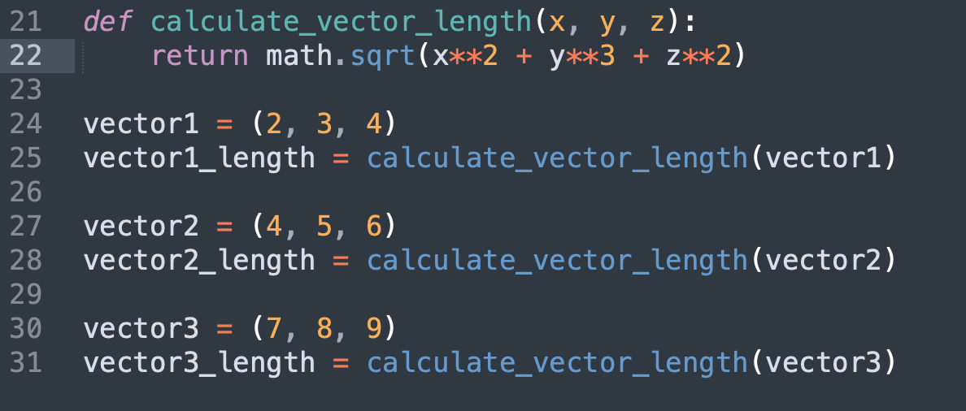
Don’t repeat yourself

Slide 21
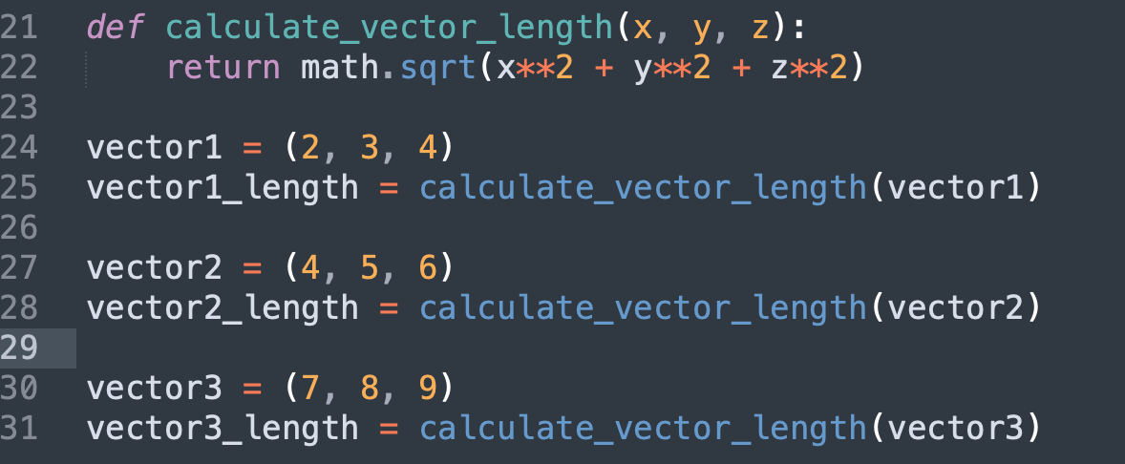
Don’t repeat yourself

Slide 22
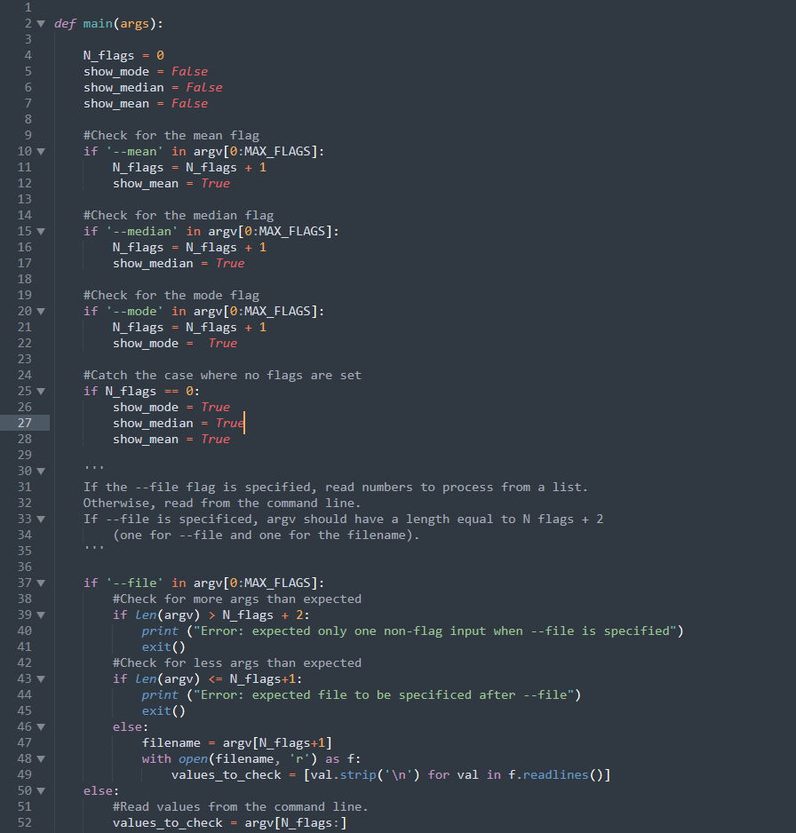
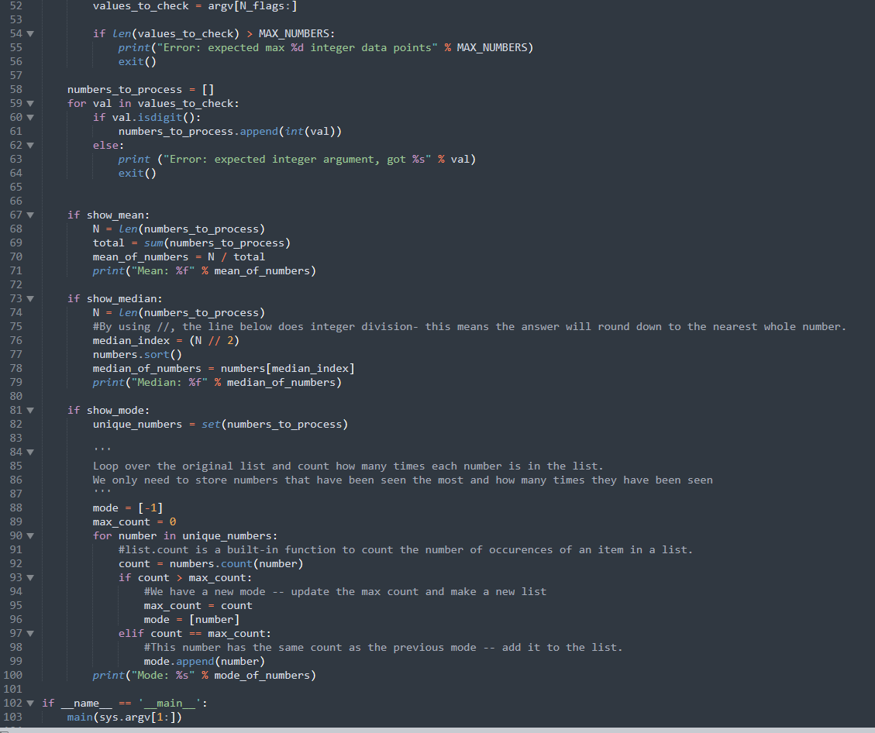
Functions improve readability

Slide 23
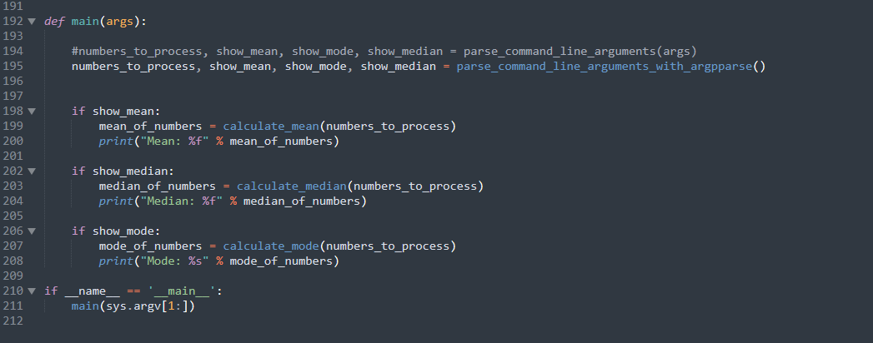
Functions improve readability

Slide 24
Functions improve readability

Slide 25
Refactoring
Long functions (i.e longer than one screen on your monitor) are much harder to read and understand.
You can make functions shorter by putting long blocks of code that naturally group together into functions- as a rule of thumb, a function should do one thing.
It’s common to write code without any functions and then later organise into functions to improve readability.
In CPA, we expect your submitted code to have been re-factored in this way.

Slide 26
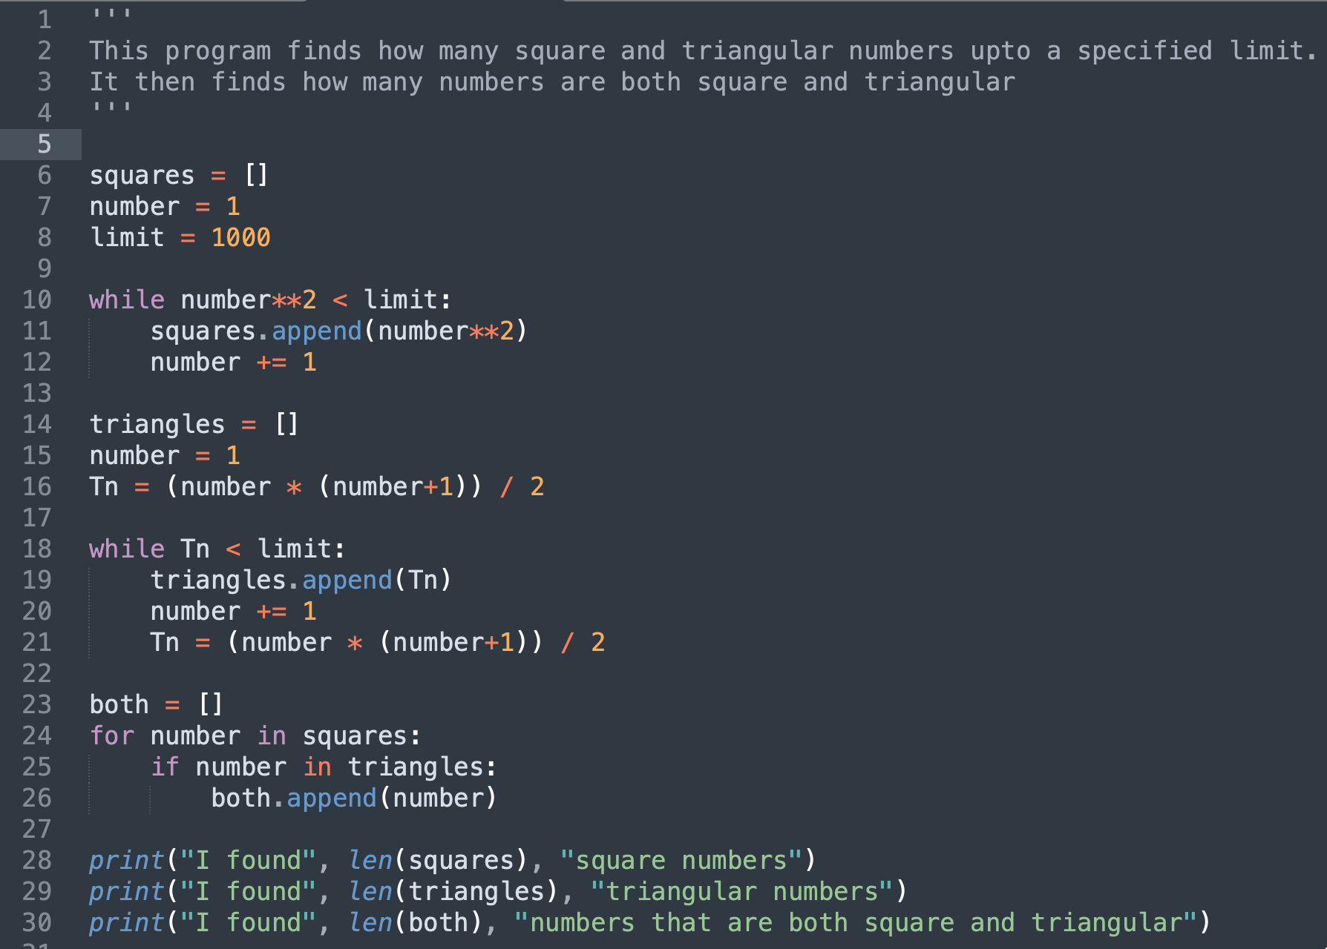
Refactoring Example 1
Enter your answer at menti.com with code 5352 1935

Slide 27
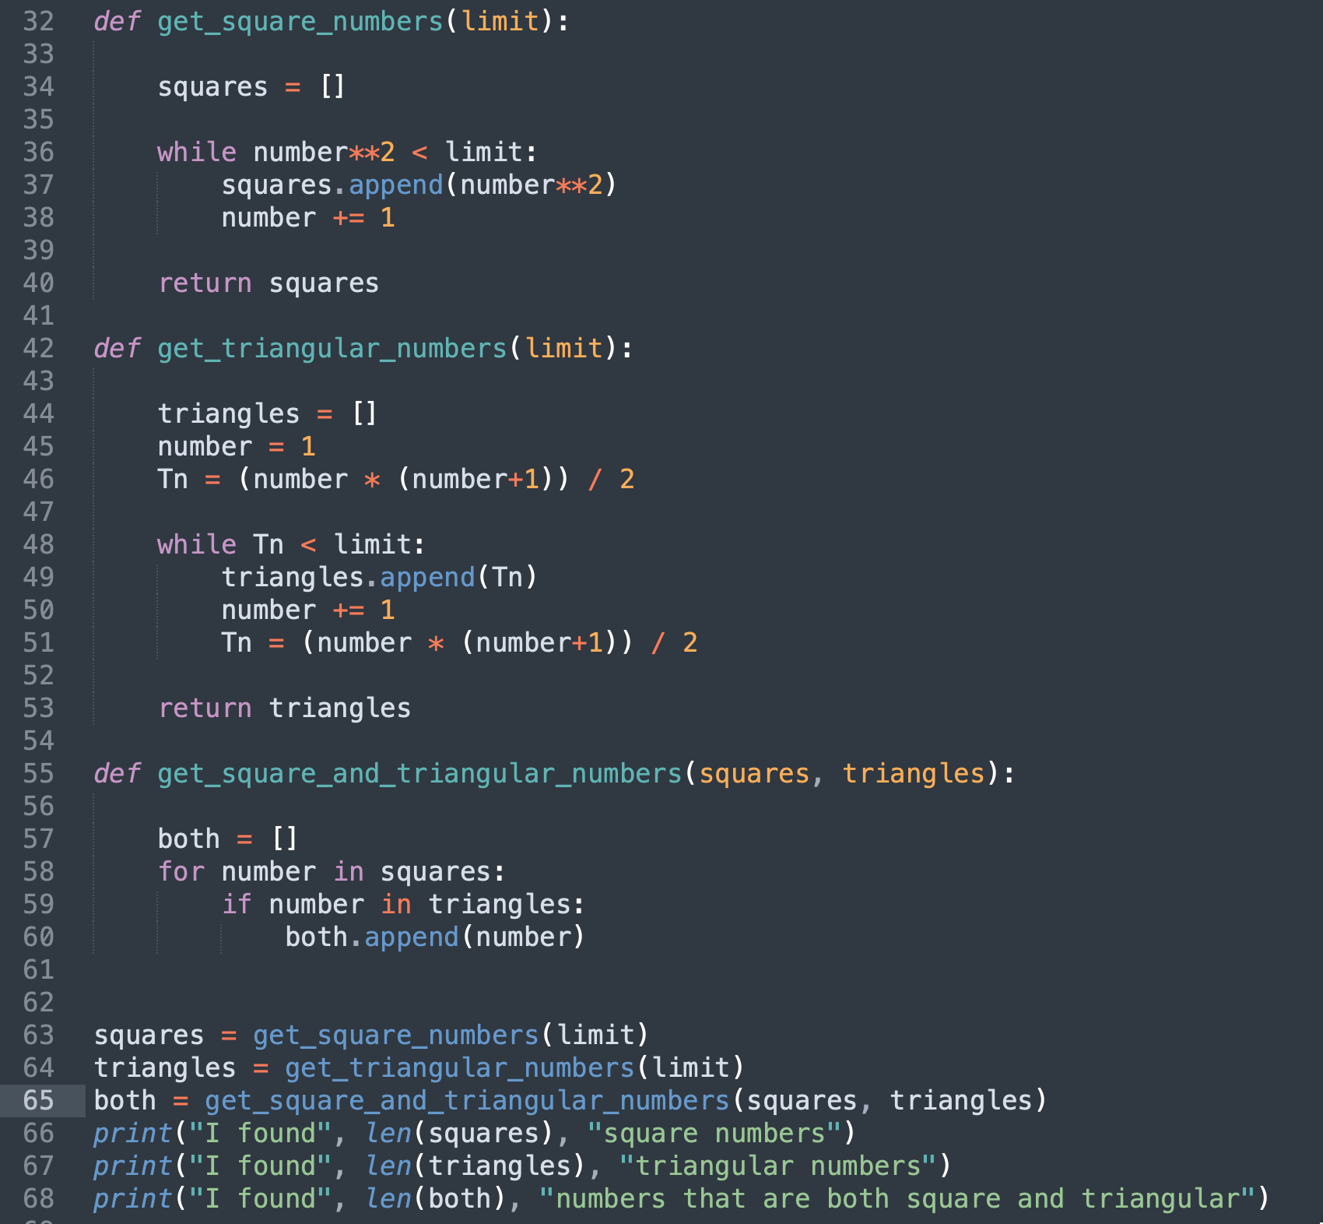
Refactoring Example 1

Slide 28
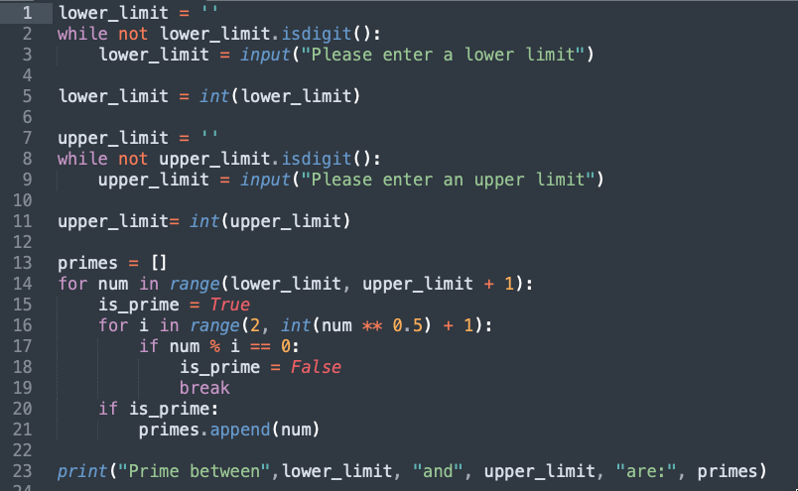
Refactoring Example 2
Enter your answer at menti.com with code 5352 1935

Slide 29
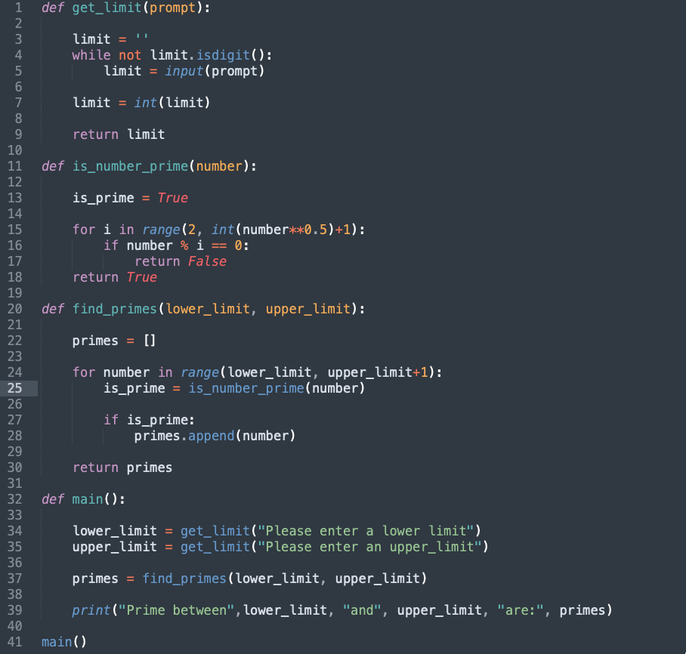
Refactoring Example 2

Slide 30
Anatomy of a python program

Slide 31
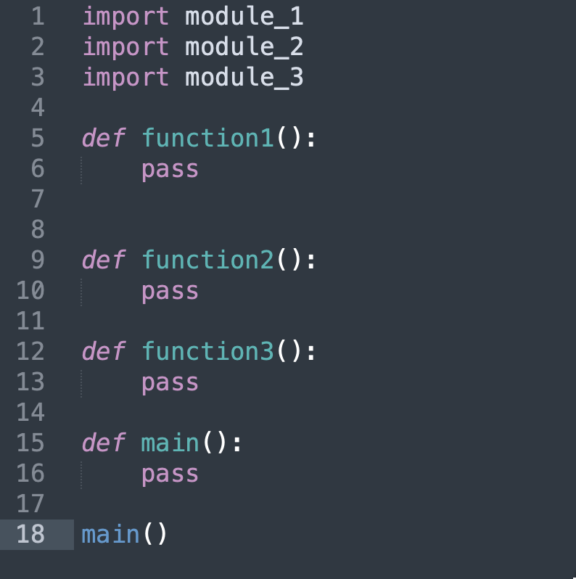
Anatomy of a python program

Slide 32
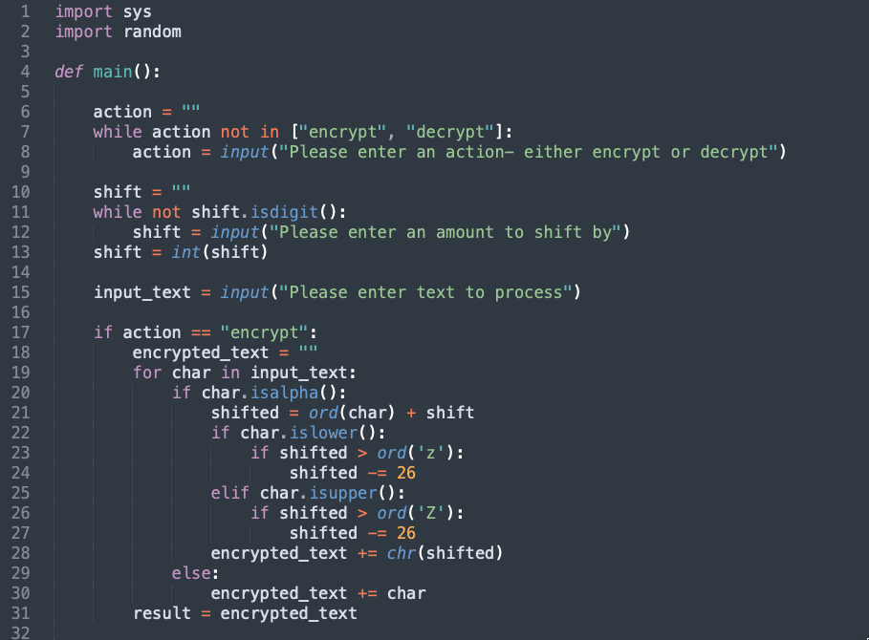
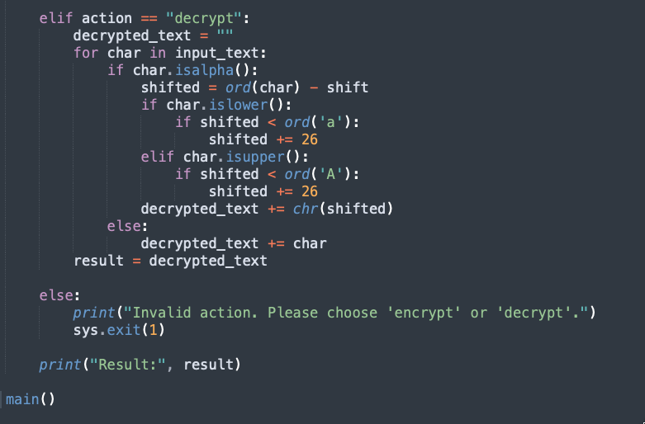
Refactoring Example 3
Enter your answer at menti.com with code 5352 1935

Slide 33
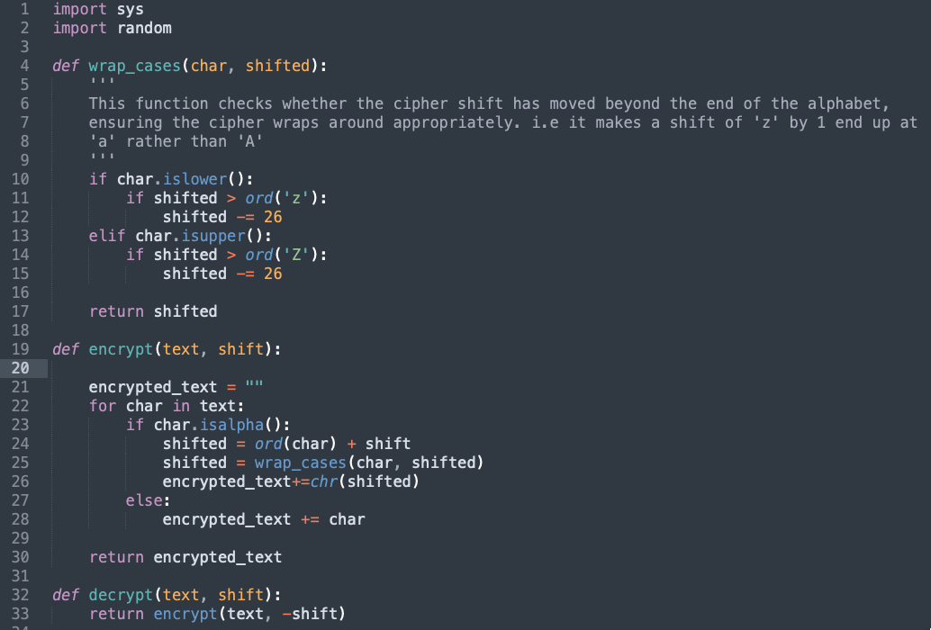
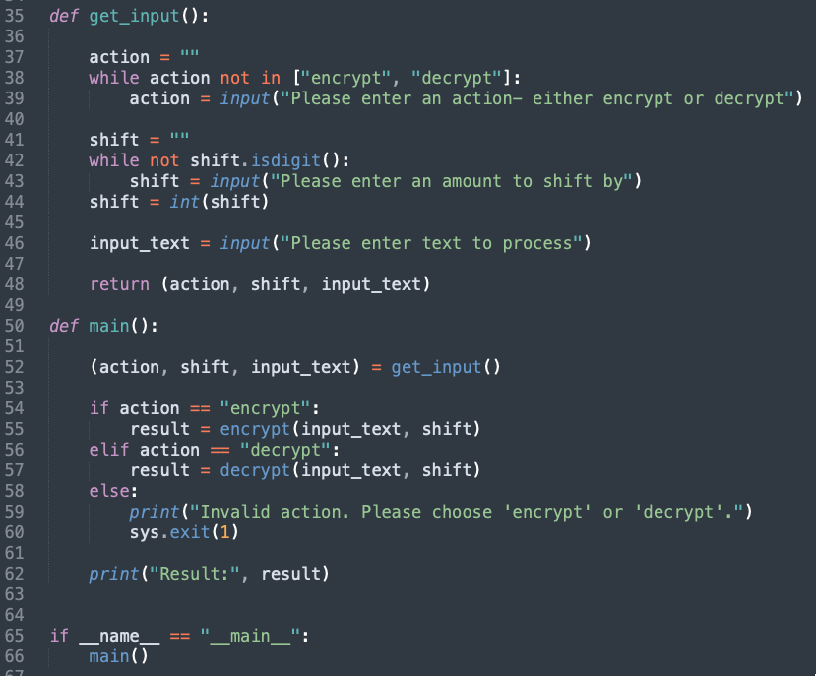
Refactoring Example 3

Slide 34
Refactoring Example 4
Look at some examples of code submitted for the first consolidation exercise- what functions would you write to make it more readable?

Slide 35
Functions - style
Functions should use lower_case_with_underscores for naming
Function names should be meaningful and informative.
Functions should have docstrings to explain:
What the function does
For longer functions, how they work
Expected inputs and outputs

Slide 36
Functions - style
Functions should use lower_case_with_underscores for naming
Function names should be meaningful and informative.
Functions should have docstrings to explain:
What the function does
For longer functions:
how they work
Expected inputs and outputs

Slide 37
Docstrings

Slide 38
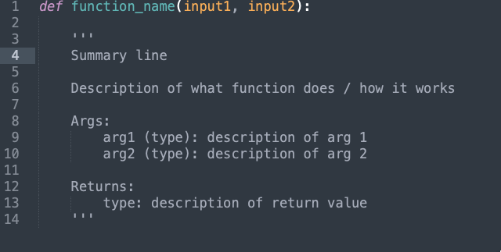
Docstrings

Slide 39
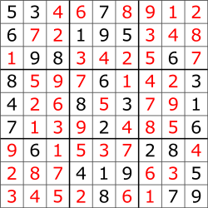
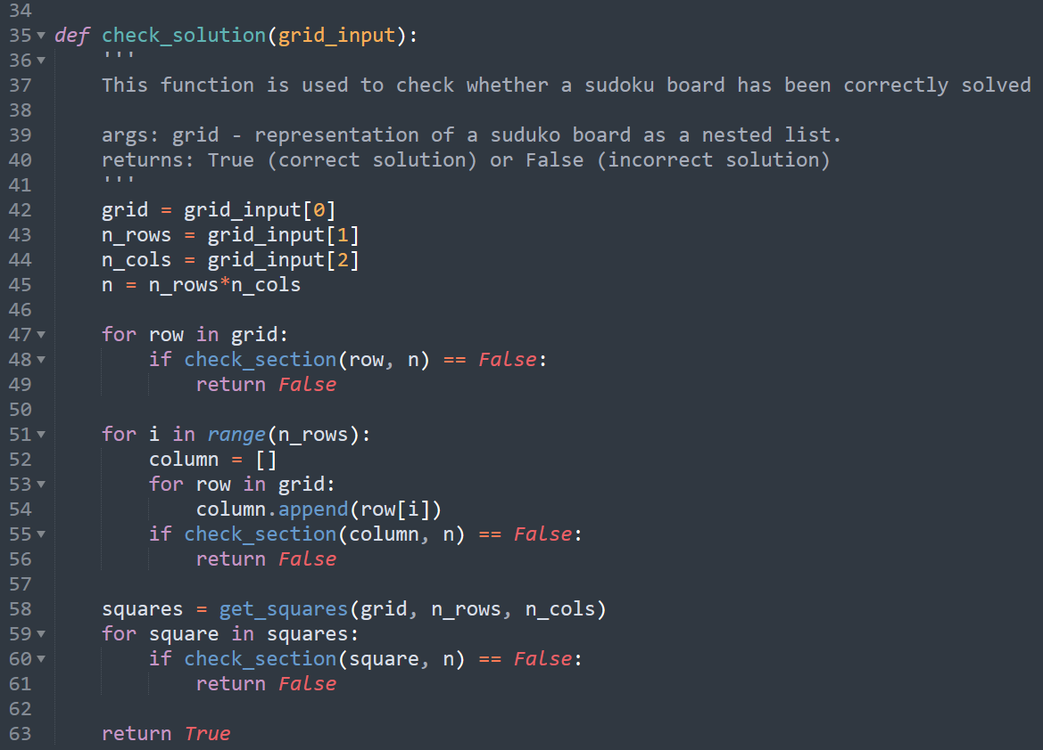
Docstrings

Slide 40
Learning Objectives
Understand that functions are blocks of code that can be called from somewhere else
Understand how functions interact with program memory and sequence of operations
Understand how we can use functions to make our code vastly more readable

